Slide 1
How autodiff changed the world
02457 Machine Learning Operations
Nicki Skafte Detlefsen,
Postdoc
DTU Compute

Slide 2
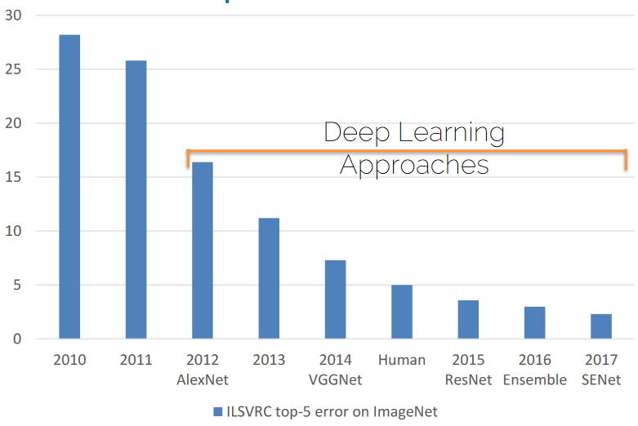
The Deep Learning Revolution

Slide 5


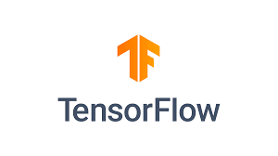

The DL software landscape
No point in discussion who is best. The (biased) facts are:
Tensorflow are too a large extend used in production
Pytorch is used in research

